Slide 1
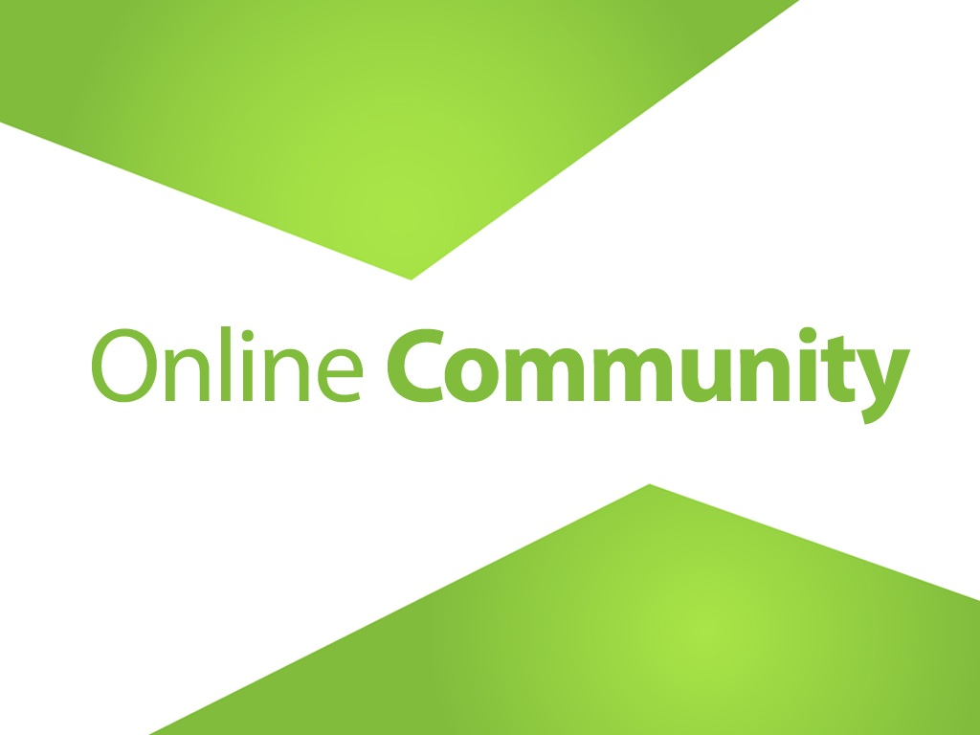

Slide 2
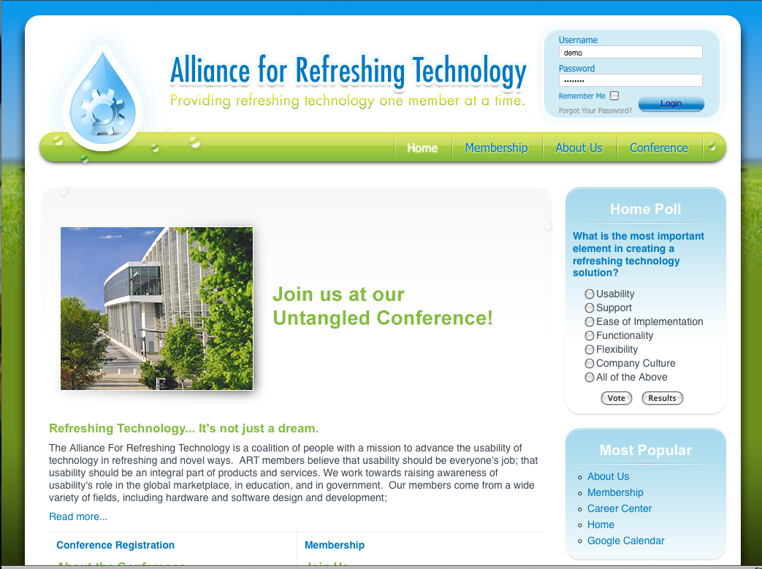
The membership community is a very powerful engagement tool. This is where you are able to create a password protected area that allows your members to have more access to information, as well as each other.

Slide 3
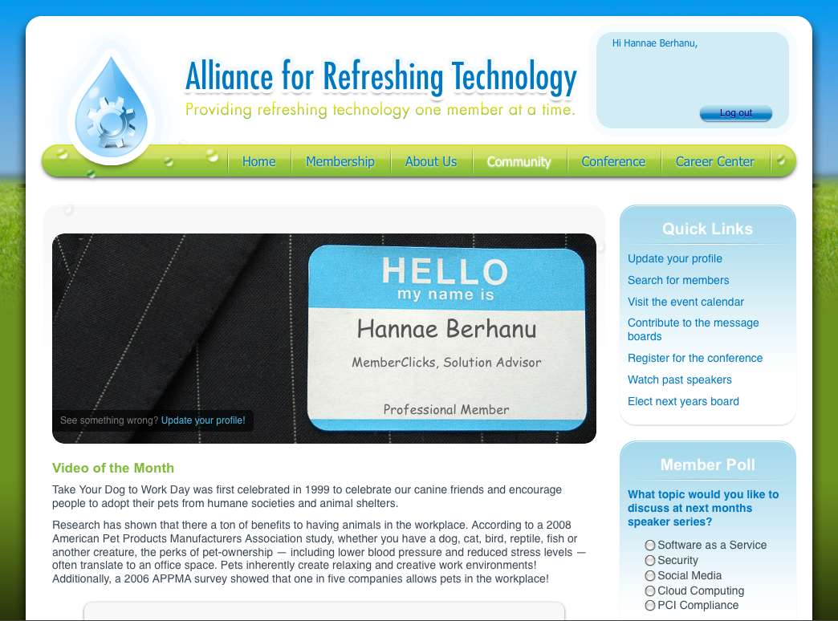
Once your members have logged into the members only area, they can be greeted by a page that is specific to them. You can have the pages address your members by name, as well as providing them with content that is specific to the group they belong to.

Slide 4
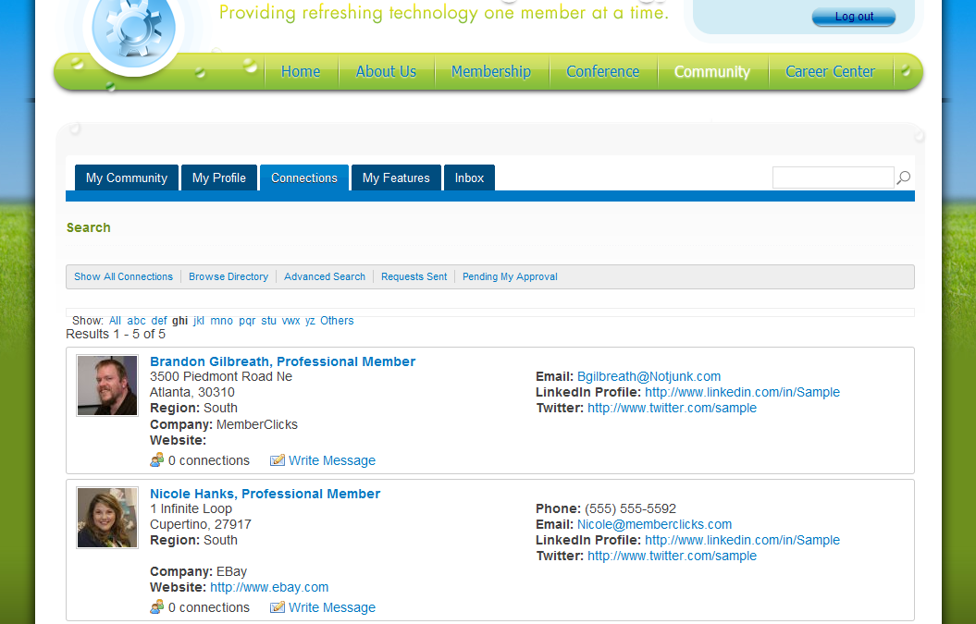
Members are also able to search for other members in the database. The information in the directory is completely customizable to your organization.

Slide 5
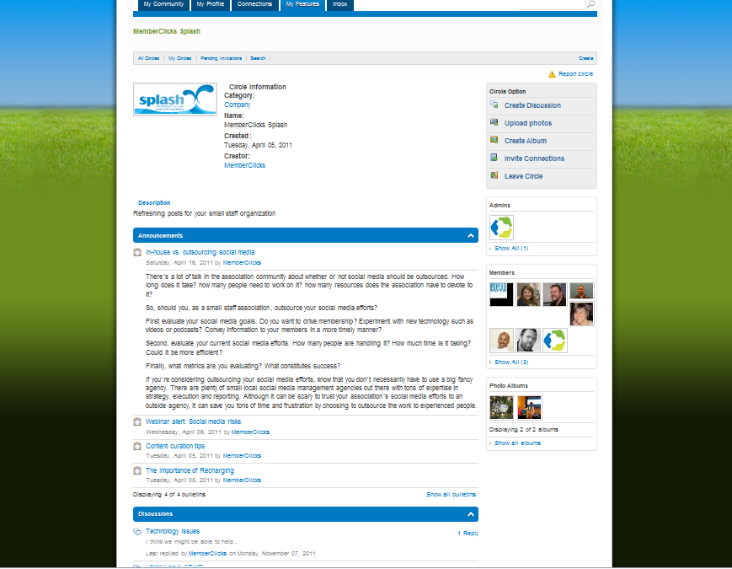
Members can communicate with each other in many different ways. Circles are a great way to allow members to subscribe to interesting topics that they would like to follow and discuss. For more information on MemberClicks social community, please click here.

Slide 6
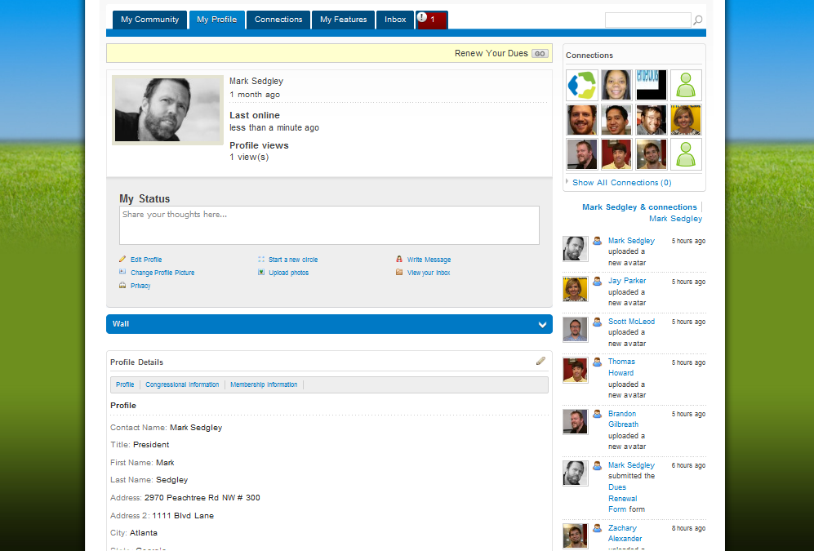
Your members profile is a very important page. This is where your members are able to decide what information they would like to have viewable in the directory, as well where your members can go to manage their committees, and e-lists.

Slide 7
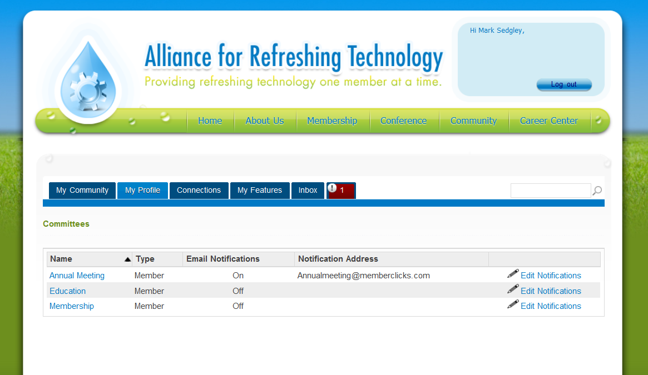
Your Members can also login to a committee area that will give them a robust committee work space. Your members can manage how they receive notifications, as well as adding messages and documents to their committee area.

Slide 8
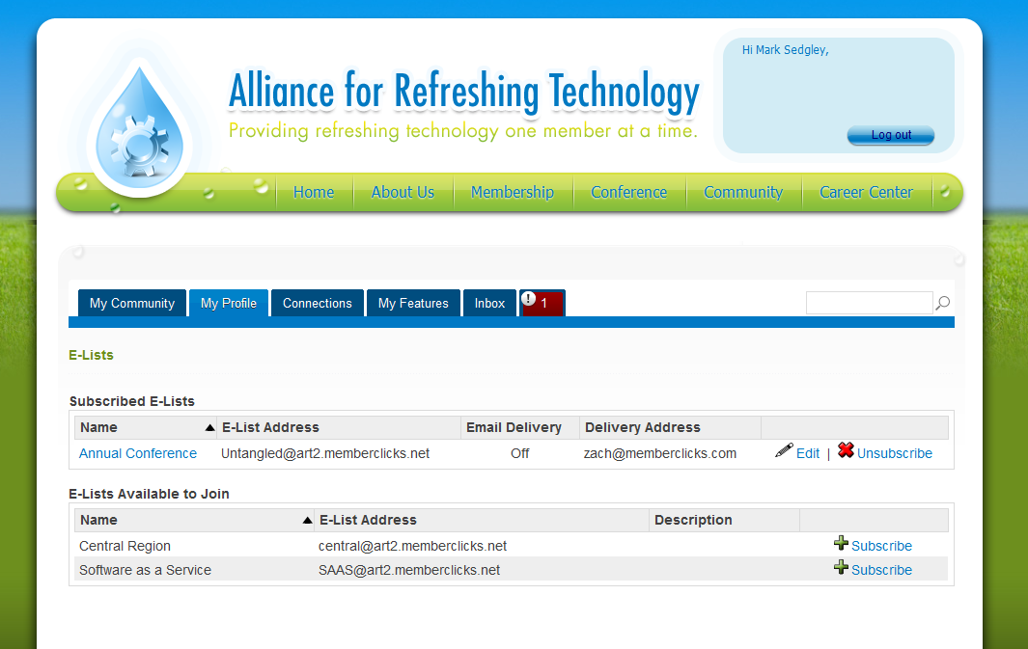
Your members can also select the e-lists they would like to be a part of, and subscribe and unsubscribe within their profile.

